Slide 1
Artist and Research

Slide 2
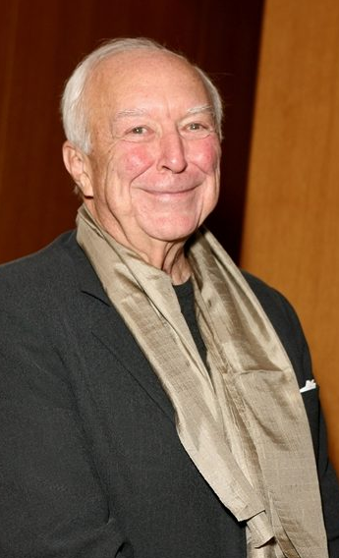
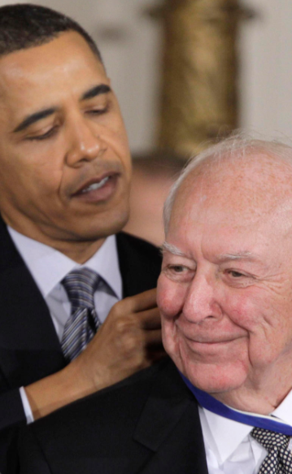
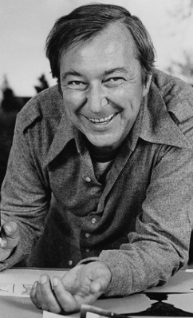
Jasper Johns
Paintings
Prints
Sculptures

Slide 3

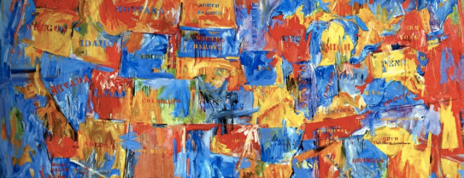




Slide 5
Branding Design

Slide 6
Layout and interaction planning

Slide 7
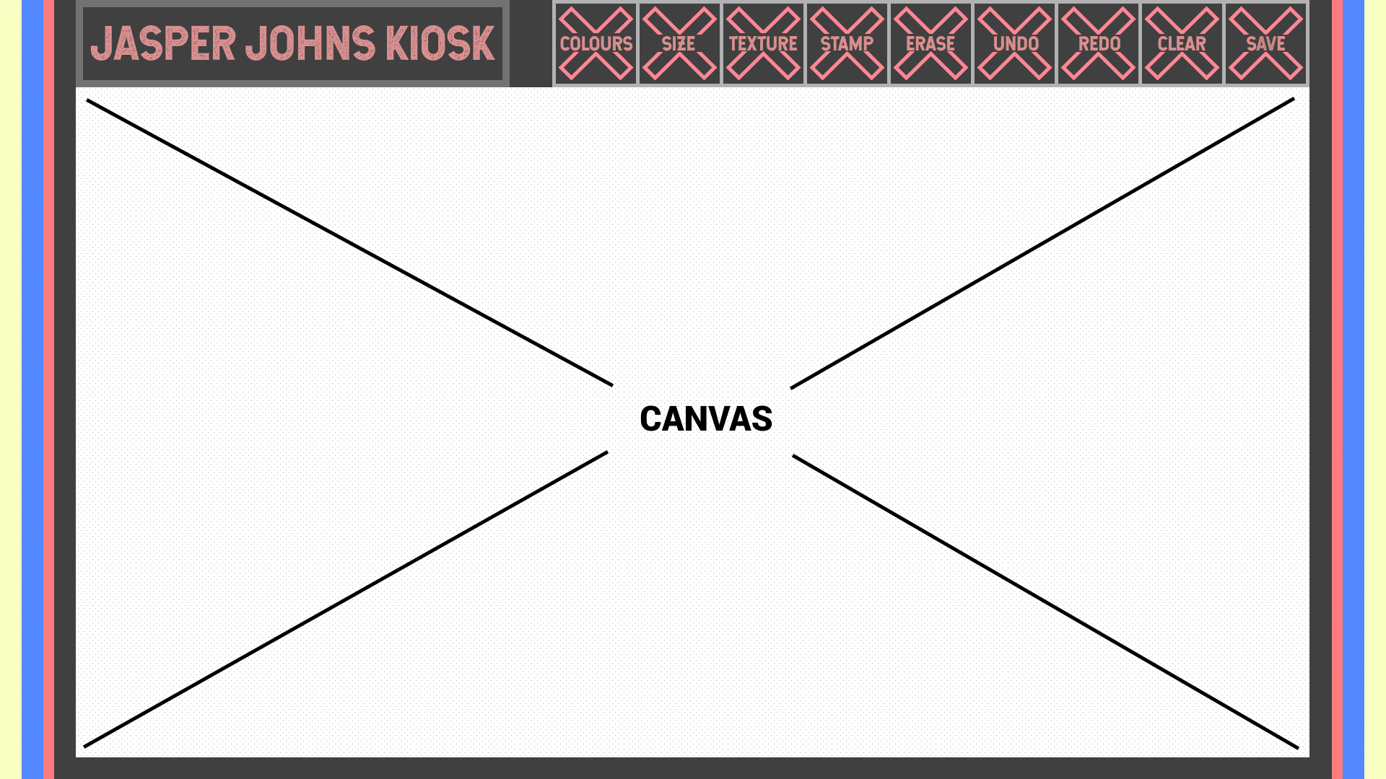

Slide 8
Technical

Slide 10
References
https://news.artnet.com/art-world/jasper-johns-wanted-young-people-to-see-his-art-the-broads-retrospective-has-pulled-it-off-1228133
http://www.jasper-johns.org/
https://www.biography.com/people/jasper-johns-9355664
https://artuk.org/discover/artists/johns-jasper-b-1930
https://www.thetimes.co.uk/article/visual-art-review-jasper-johns-something-resembling-truth-at-the-royal-academy-w1-zghg86g3h
http://www.artnews.com/2014/11/11/36-m-flag-sets-jasper-johns-record-at-sothebys-343-7-m-contemporary-art-auction/
https://www.moma.org/collection/works/78393
https://thewestologist.wordpress.com/tag/jasper-johns/

